Slide 1



More is Different Prototyping and Analyzing a New Form of Edge Server with Massive Mobile SoCs
2024 USENIX Annual Technical Conference
Li Zhang¹, Zhe Fu², Boqing Shi¹, Xiang Li¹, Rujin Lai³, Chenyang Yang³, Ao Zhou¹, Xiao Ma¹, Shangguang Wang¹, Mengwei Xu¹
¹Beijing University of Posts and Telecommunications (BUPT) ²Tsinghua University, ³vclusters

Slide 2
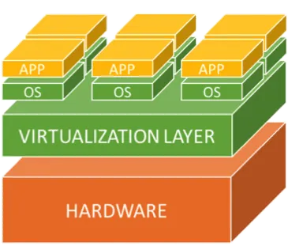
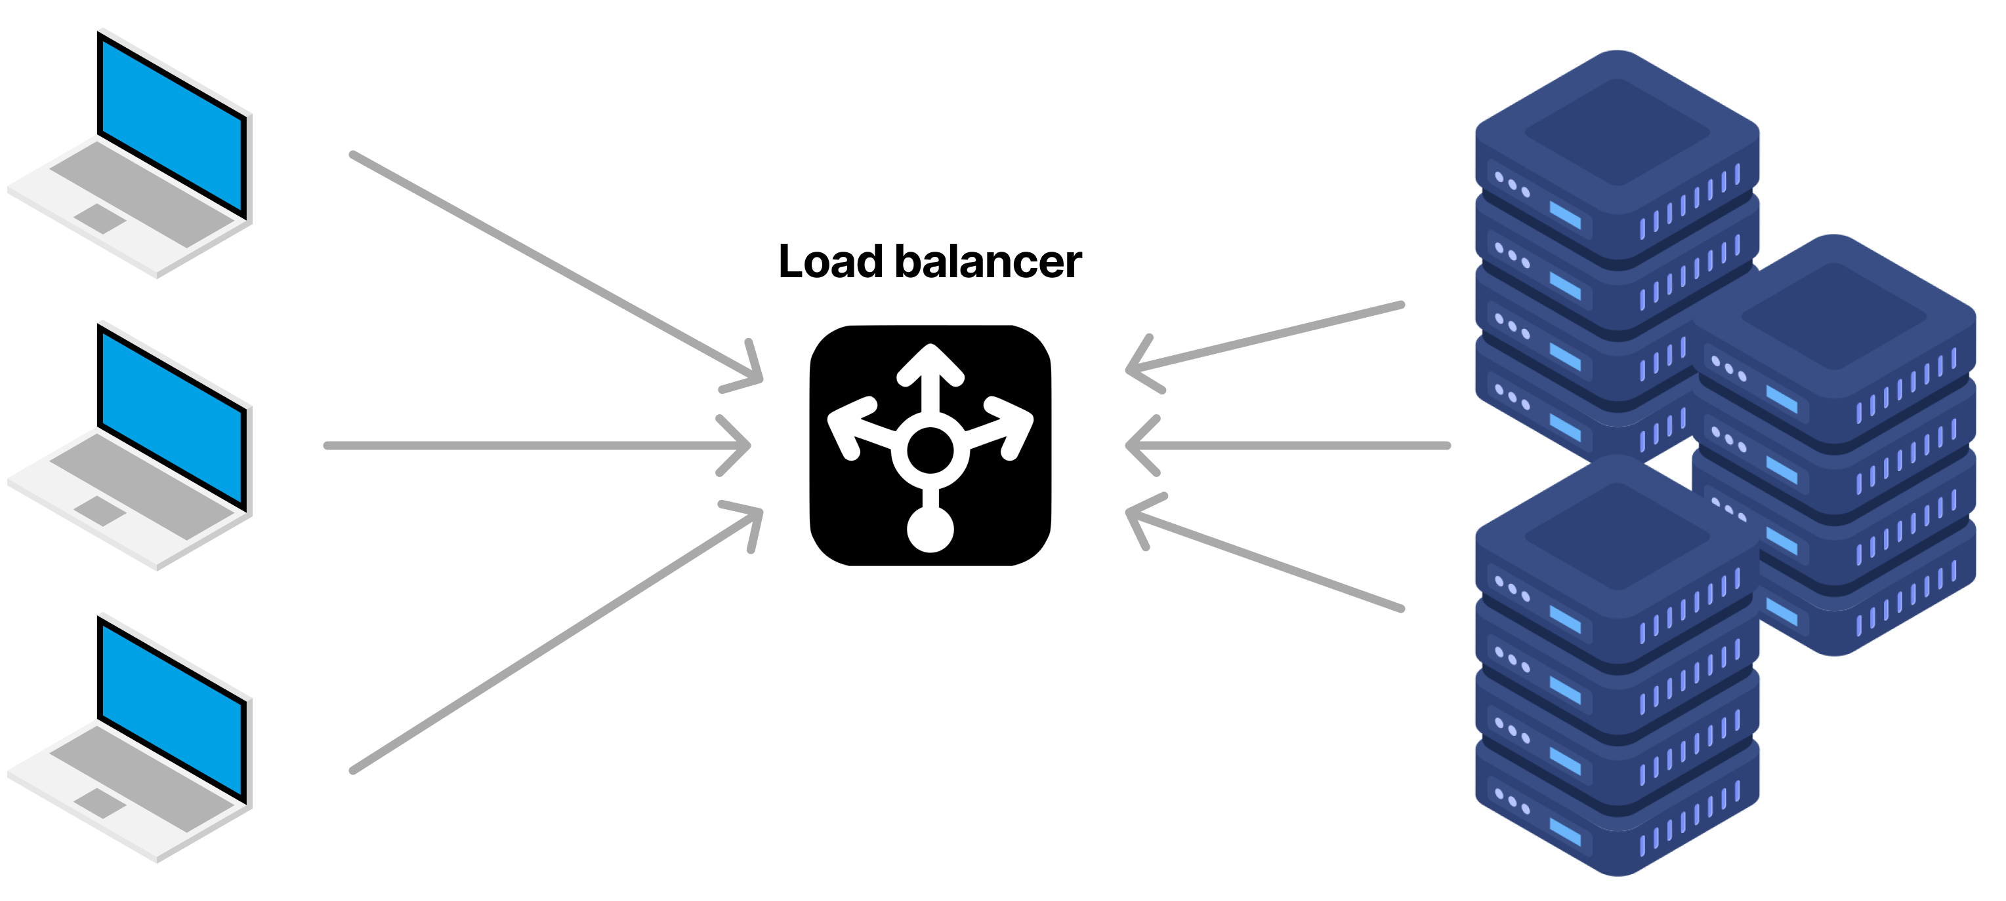
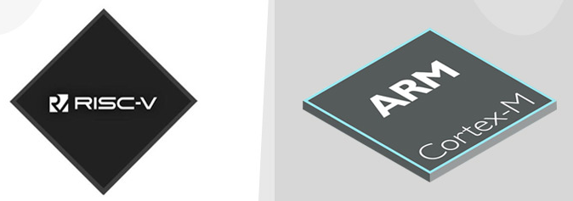
Power Consumption of Datacenters
High power consumption: A historical and persistent issue
Workloads: Large language model training/inference, big data analytics, video streaming, etc.
How to build energy-efficient datacenters?
Software optimizations: Resource virtualization, load balancing, …
Hardware optimizations: Use RISC architecture, lower process nodes, …
Software-level Optimizations
Hardware-level Optimizations

Slide 3

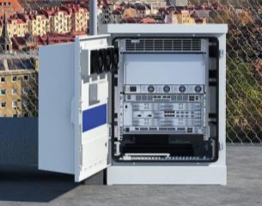



Cloud vs. Edge: Key Factors
Cherry-picked and Large
Location and Spaces
Near-population and Limited
Abundant and Cheap
Power Supply
Constrained and Expensive
Powerful and Mature
Colling Facility
Wimpy or Even Missed
Various Types, Stable/Predictable
Workloads
Specific and Highly Variational

Slide 4



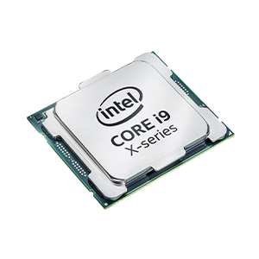
Cloud vs. Edge: Hardware Selection
DSA (GPU, TPU, FPGA, etc.)
Motherboard Bus
Many-core CPUs
Monolithic Servers
Cherry-picked and Large
Location and Spaces
Near-population and Limited
Abundant and Cheap
Power Supply
Constrained and Expensive
Powerful and Mature
Colling Facility
Wimpy or Even Missed
Various Types, Stable/Predictable
Workloads
Specific and Highly Variational

Slide 5
Cloud vs. Edge: Hardware Selection
DSA (GPU, TPU, FPGA, etc.)
DSA (GPU, TPU, FPGA, etc.)
Motherboard Bus
Motherboard Bus
Many-core CPUs
Many-core CPUs
Monolithic Servers
Monolithic Servers
Cherry-picked and Large
Location and Spaces
Near-population and Limited
Abundant and Cheap
Power Supply
Constrained and Expensive
Powerful and Mature
Colling Facility
Wimpy or Even Missed
Various Types, Stable/Predictable
Workloads
Specific and Highly Variational

Slide 6

Cloud vs. Edge: Hardware Selection
DSA (GPU, TPU, FPGA, etc.)
Motherboard Bus
Many-core CPUs
Monolithic Servers
Cherry-picked and Large
Location and Spaces
Near-population and Limited
Abundant and Cheap
Power Supply
Constrained and Expensive
Powerful and Mature
Colling Facility
Wimpy or Even Missed
Various Types, Stable/Predictable
Workloads
Specific and Highly Variational

Slide 7

Cloud vs. Edge: Hardware Selection
DSA (GPU, TPU, FPGA, etc.)
Motherboard Bus
Many-core CPUs
Monolithic Servers
Smartphones!
Intrinsic benefits of smartphones at the edge
Higher energy efficiency of mobile processors compared to traditional datacenter servers
Heterogeneous co-processors like mobile GPU, NPU, video codec, etc.
Ability to run mobile operating systems and apps

Slide 8

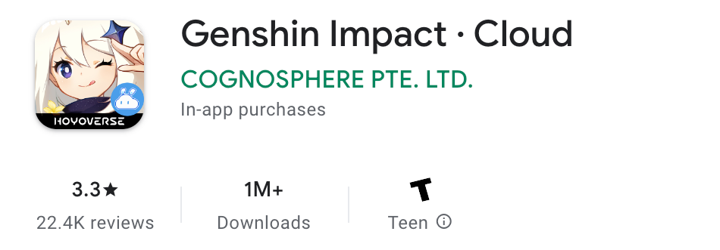
Killer Workload: Mobile Cloud Gaming
Mobile cloud gaming services: Enable wimpy mobile devices to run immersive, resource-consuming (computing and disk) mobile games released in recent years.
Business success: Genshin Impact gains
> 5B USD income dated to Feb. 2024.
> 1M downloads of its cloud gaming version dated to July 2024.
Underlying rationale: Mobile games are optimized for mobile platforms/processors

Slide 9
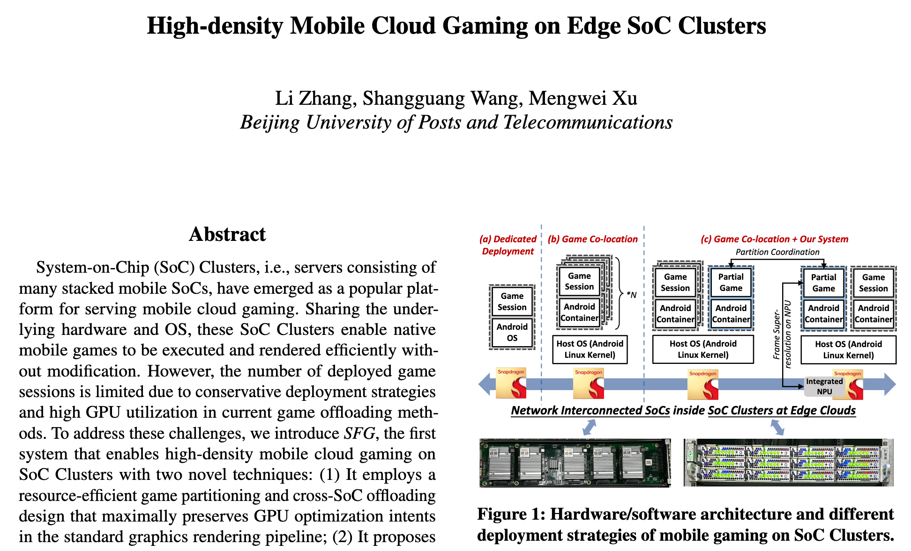
Killer Workload: Mobile Cloud Gaming

Slide 10
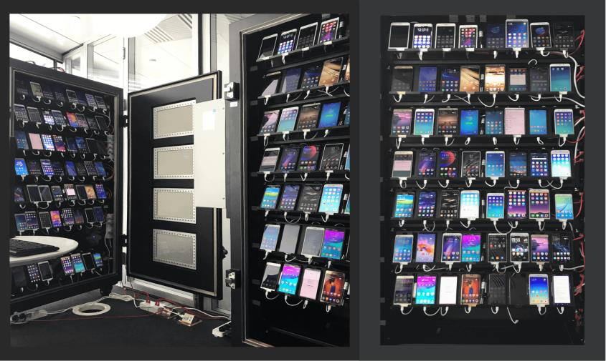
Massive Smartphones in the Cloud
Physical Smartphone Farms
AWS Device Farm, Google Firebase Test Lab, Douyin Device Farm^{[1]}
^{[1]} [MobiCom’23] Hao Lin et al. Virtual Device Farms for Mobile App Testing at Scale: A Pursuit for Fidelity, Efficiency, and Accessibility

Slide 11
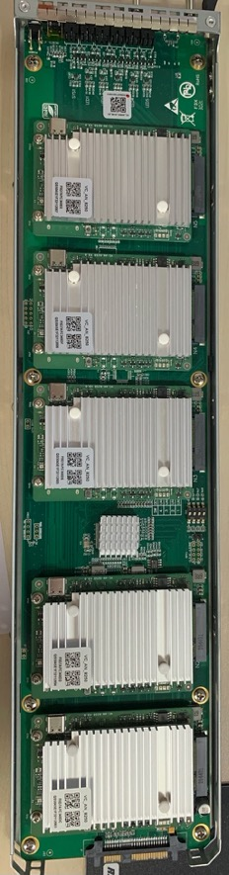
Massive Mobile SoCs at the Edge
✘ Screen
✘ Battery
✅ Direct Power Supply
✅ Ethernet
Physical Smartphone Farms
Massive Individual Mobile SoCs
AWS Device Farm, Google Firebase Test Lab, Douyin Device Farm^{[1]}
Stability & Higher Density & Higher Energy Efficiency
^{[1]} [MobiCom’23] Hao Lin et al. Virtual Device Farms for Mobile App Testing at Scale: A Pursuit for Fidelity, Efficiency, and Accessibility

Slide 12
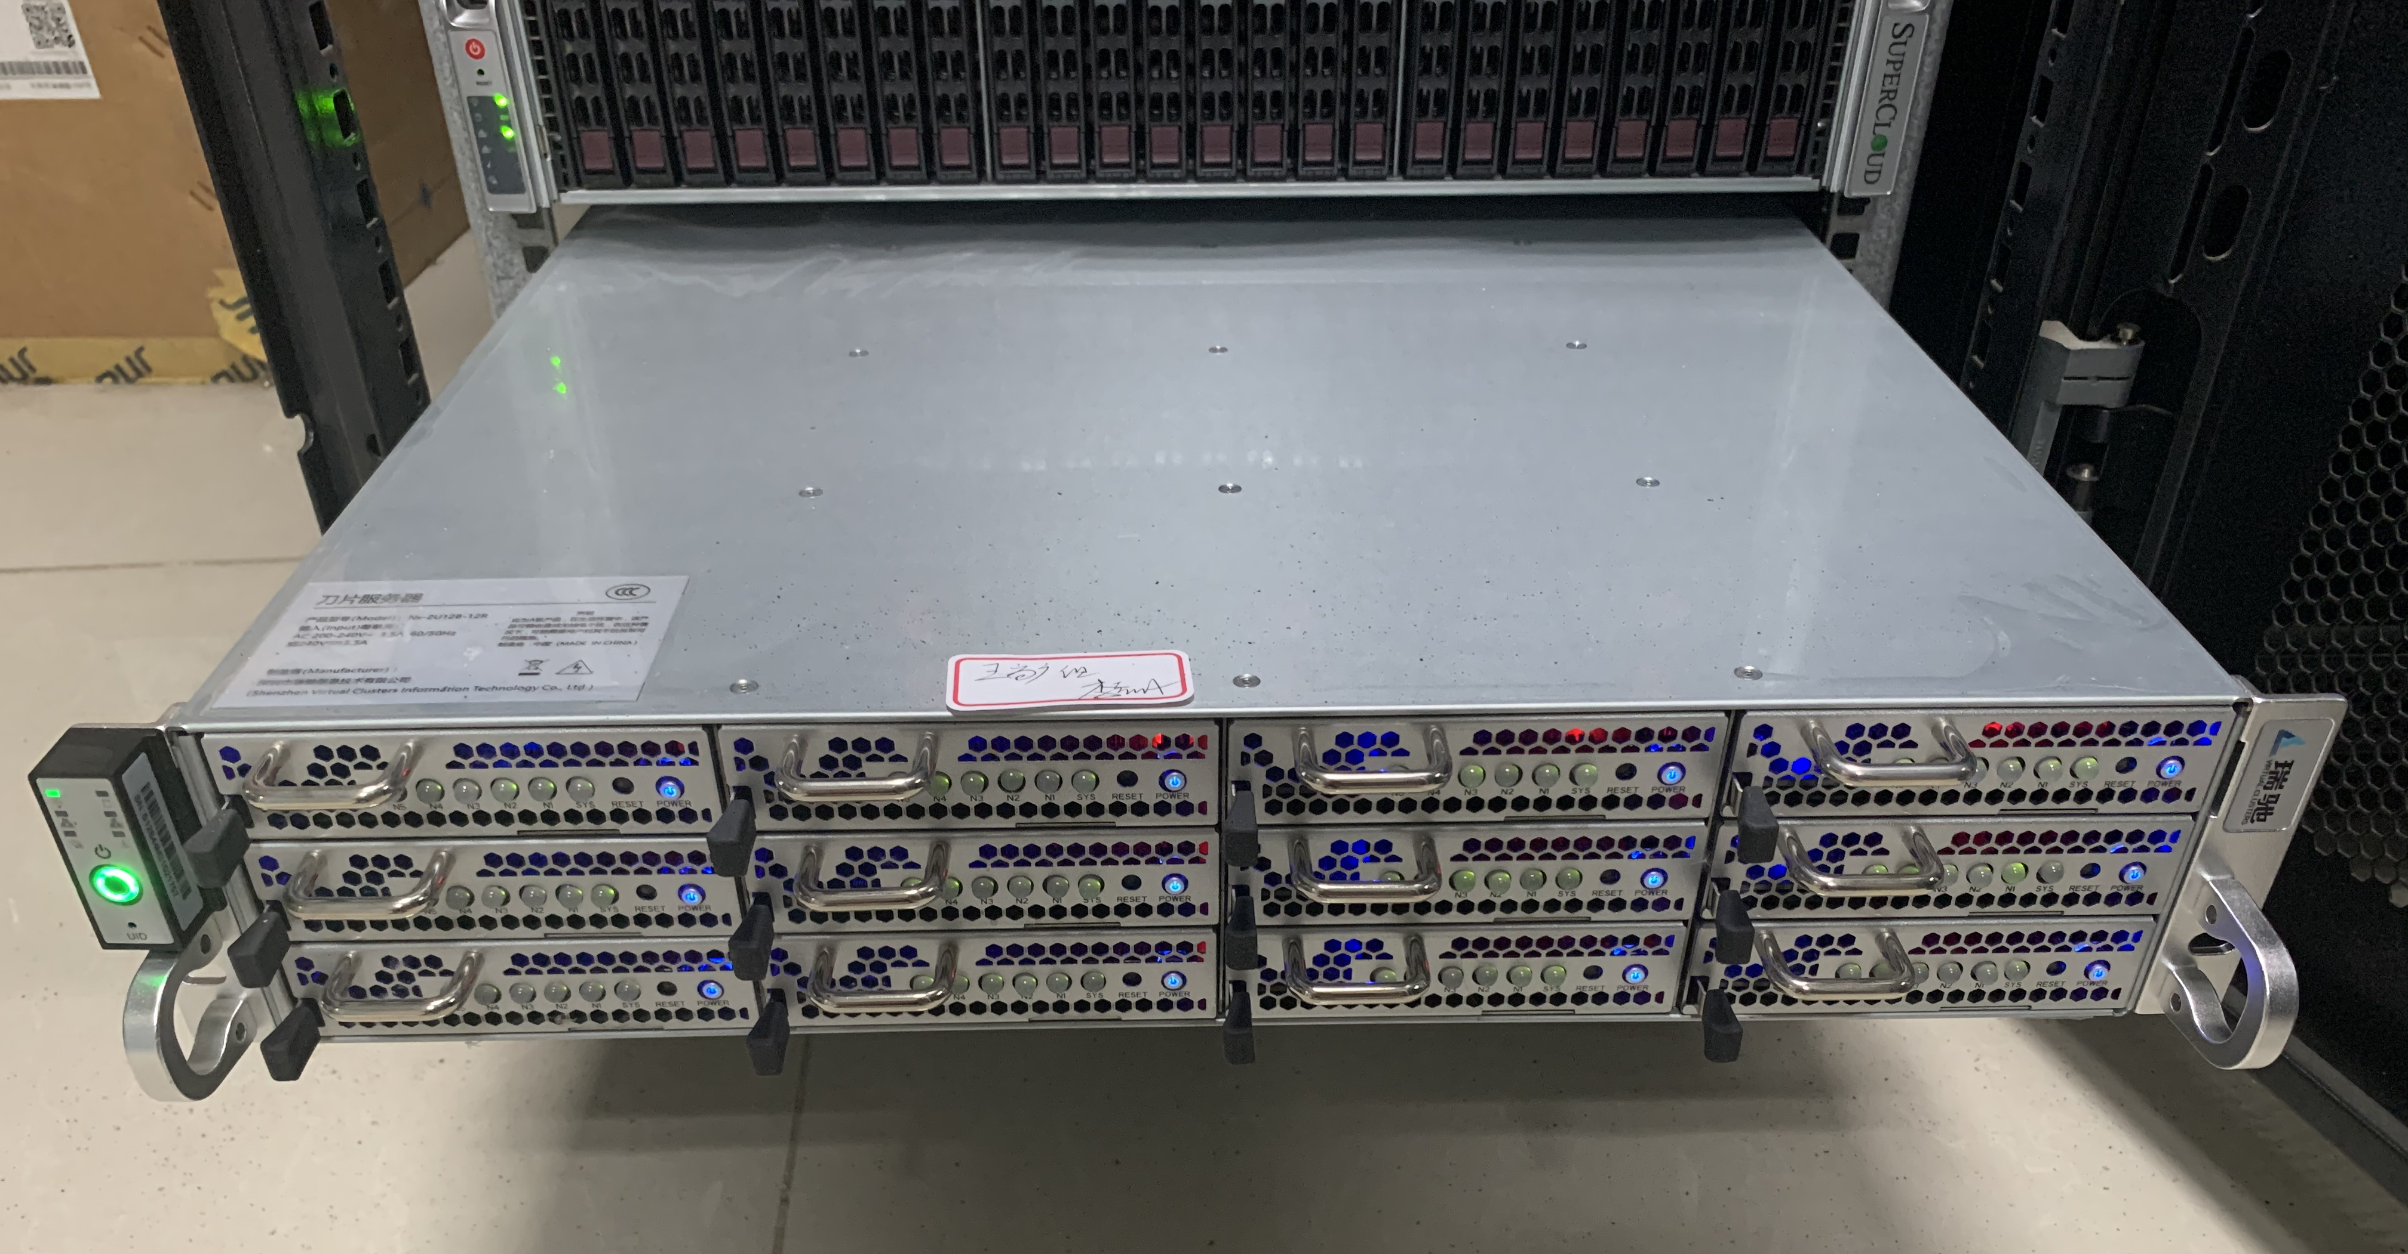
A Close Look at an SoC Cluster
A commercial SoC Cluster
Massive Individual Mobile SoCs
In-the-wild deployment in edge clouds
Support mobile cloud gaming, cloud phone services

Slide 13

A Close Look at an SoC Cluster
A Physcal SoC Cluster
Network Interface
Network Interface
Ethernet Switch Board
Network Interface
Backplane
Baseboard Management Controller
Network & Power supply
Web
Backend
SoC 1
SoC 1
SoC 1
Manager APIs
SoC 2
SoC 2
SoC 2
SoC 3
SoC 3
SoC 3
Power
Manager
SoC 4
SoC 4
SoC 4
PCB/SoC
Manager
SoC 5
SoC 5
SoC 5
PCB 3
PCB 2
PCB 1
Thermal
Manager
Cooling Devices
Linux OS
The Conceptual Architecture of an SoC Cluster
A Internal PCB board with 5 SoCs

Slide 14
A Close Look at an SoC Cluster
A Physcal SoC Cluster
Network Interface
Network Interface
Ethernet Switch Board
Network Interface
Backplane
Baseboard Management Controller
Network & Power supply
Web
Backend
SoC 1
SoC 1
SoC 1
Manager APIs
SoC 2
SoC 2
SoC 2
SoC 3
SoC 3
SoC 3
Power
Manager
SoC 4
SoC 4
SoC 4
PCB/SoC
Manager
SoC 5
SoC 5
SoC 5
PCB 3
PCB 2
PCB 1
Thermal
Manager
Cooling Devices
Linux OS
The Conceptual Architecture of an SoC Cluster
Computing units: Every 5 mobile SoCs are integrated into one printable circuit board (PCB). (60 SoCs in total)
A Internal PCB board with 5 SoCs
Notes:
printable circuit board
sixty

Slide 15
A Close Look at an SoC Cluster
Ethernet Switch Board
Computing units: Every 5 mobile SoCs are integrated into one printable circuit board (PCB). (60 SoCs in total)
Networking: One backplane and one Ethernet Switch Board (20 Gbps); 2-layer Ethernet networking and power supply
Network Interface
Network Interface
Network Interface
Backplane
Baseboard Management Controller
Network & Power supply
Web
Backend
SoC 1
SoC 1
SoC 1
Manager APIs
SoC 2
SoC 2
SoC 2
SoC 3
SoC 3
SoC 3
Power
Manager
SoC 4
SoC 4
SoC 4
PCB/SoC
Manager
SoC 5
SoC 5
SoC 5
PCB 3
PCB 2
PCB 1
Thermal
Manager
Cooling Devices
Linux OS
The Conceptual Architecture of an SoC Cluster

Slide 16
A Close Look at an SoC Cluster
Ethernet Switch Board
Computing units: Every 5 mobile SoCs are integrated into one printable circuit board (PCB). (60 SoCs in total)
Networking: One backplane and one Ethernet Switch Board (20 Gbps); 2-layer Ethernet networking and power supply
Server management: One baseboard management controller (BMC); SoC/PCB controller, thermal manager, etc.
Network Interface
Network Interface
Network Interface
Backplane
Baseboard Management Controller
Network & Power supply
Web
Backend
SoC 1
SoC 1
SoC 1
Manager APIs
SoC 2
SoC 2
SoC 2
SoC 3
SoC 3
SoC 3
Power
Manager
SoC 4
SoC 4
SoC 4
PCB/SoC
Manager
SoC 5
SoC 5
SoC 5
PCB 3
PCB 2
PCB 1
Thermal
Manager
Cooling Devices
Linux OS
The Conceptual Architecture of an SoC Cluster

Slide 17
A Close Look at an SoC Cluster
Ethernet Switch Board
Computing units: Every 5 mobile SoCs are integrated into one printable circuit board (PCB). (60 SoCs in total)
Networking: One backplane and one Ethernet Switch Board (20 Gbps); 2-layer Ethernet networking and power supply
Server management: One baseboard management controller (BMC); SoC/PCB controler, thermal manager, etc.
Cooling devices: 8 fans
Network Interface
Network Interface
Network Interface
Backplane
Baseboard Management Controller
Network & Power supply
Web
Backend
SoC 1
SoC 1
SoC 1
Manager APIs
SoC 2
SoC 2
SoC 2
SoC 3
SoC 3
SoC 3
Power
Manager
SoC 4
SoC 4
SoC 4
PCB/SoC
Manager
SoC 5
SoC 5
SoC 5
PCB 3
PCB 2
PCB 1
Thermal
Manager
Cooling Devices
Linux OS
The Conceptual Architecture of an SoC Cluster

Slide 18
Trace Anslysis of Mobile Cloud Gaming
Real-world traces: Network traffic of an in-the-wild SoC Cluster over 38 hours, only serving mobile cloud gaming services
Up to 25x Outbound Traffic Gap
High hardware usage variation drives us to explore whether SoC Clusters can efficiently support other workloads.

Slide 19
Resource Subscription of Cloud/Edge VMs
Smartphone Configuration: Qualcomm Snapdragon 865 (released in 2020), 8 CPU cores, 12 GB memory, 256 GB storage
Two VM subscription traces: Microsoft Azure Cloud VMs^{[1]} and Alibaba ENS Edge VMs ^{[2]}
^{[1]} [SOSP’17] Eli Cortez, et al. Resource Central: Understanding and Predicting Workloads for Improved Resource Management in Large Cloud Platforms
^{[2]} [IMC’21] Mengwei Xu, et al. From cloud to edge: a first look at public edge platforms

Slide 20
Resource Subscription of Cloud/Edge VMs
Smartphone Configuration: Qualcomm Snapdragon 865 (released in 2020), 8 CPU cores, 12 GB memory, 256 GB storage
Two VM subscription traces: Microsoft Azure Cloud VMs^{[1]} and Alibaba ENS Edge VMs ^{[2]}
Observation Smartphone hardware limits > VM subscription confs:
66% of Azure Cloud VMs
36% of ENS Edge VMs
0.93, 8C
0.72, 256GB
0.66, 12GB
0.5, 8C
0.36, 12GB

Slide 21
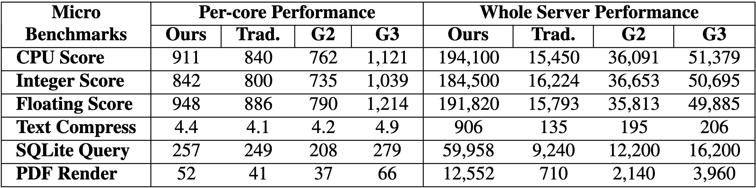
Micro-benchmarks on CPU
Micro-benchmarks: Geekbench 5
Hardware:
One traditional edge server with Intel Xeon 5218R CPU (40 cores)
AWS Graviton 2/3 cloud instances with ARM CPUs (m6/7g.metal, 64 cores)
An SoC Cluster (60 * 8 cores, Qualcomm Snapdragon 865 SoC)
SoC Cluster aligns closely with Trad. Intel CPU server, outperforming AWS Graviton 2 but not matching the performance of the AWS Graviton 3 instance.

Slide 22
Micro-benchmarks on CPU
Micro-benchmarks: Geekbench 5
Hardware:
One traditional edge server with Intel Xeon 5218R CPU (40 cores)
AWS Graviton 2/3 cloud instances with ARM CPUs (m6/7g.metal, 64 cores)
An SoC Cluster (60 * 8 cores, Qualcomm Snapdragon 865 SoC)
The large number of SoC CPU cores delivers superior performance compared to other CPU servers.

Slide 23
SoC Cluster Benchmark
Video transcoding: Live streaming transcoding & archive transcoding
Software: FFmpeg & LiTr^{[1]}
Dataset: 6 videos picked from vbench^{[2]} with diverse video complexities
Metrics: Throughput, energy efficiency, video bitrate, video quality
Deep learning (DL) serving
Software: TVM on Intel CPU; TensorRT on NVIDIA GPU; TFLite on SoC Clusters
Models: ResNet-50 (FP32/INT8), ResNet-152 (FP32/INT8), YOLOv5x (FP32), BERT (FP32)
Metrics: Latency, throughput, energy efficiency
Alternative Hardware
One physical edge server: Intel Xeon 5218R Gold Processor (40 cores)
Datacenter-level GPUs: NVIDIA A40 & NVIDIA A100
[1] https://github.com/linkedin/LiTr
[2] [ASPLOS’18] Andrea Lottarini et al. vbench: Benchmarking Video Transcoding in the Cloud

Slide 24
Video Transcoding
Question #1: How much energy efficiency can be gained by using SoC Clusters for video transcoding?
Task: Live streaming transcoding
Energy efficiency: The number of streams a single watt can support
The Higher The Better
SoC CPUs are up to 3.2x more energy-efficient than the Intel CPU, and up to 4.5x more energy efficient than the NVIDIA A40 GPU.

Slide 25
Video Transcoding
Task: Archive transcoding (more computation required than live streaming transcoding)
Energy efficiency: The number of frames a single Joule can process
The Higher The Better
SoC CPUs still achieve higher energy efficiency than the Intel CPU.
SoC CPUs only outperform the NVIDIA A40 GPU in simple (low-complexity) videos (i.e. V2 and V4), but fails in more complex ones.

Slide 26

Video Transcoding
Question #2: To what extent do SoC codecs outperform SoC CPUs?
Task: Live streaming transcoding
Metrics
Throughput: The number of streams a whole SoC Cluster can support
Energy efficiency: The number of streams a single watt can support
Throughput: 1.07x – 3x improvement.
3x

Slide 27
Video Transcoding
Question #2: To what extent do SoC codecs outperform SoC CPUs?
Task: Live streaming transcoding
Metrics
Throughput: The number of streams a whole SoC Cluster can support
Energy efficiency: The number of streams a single watt can support
Throughput: 1.07x – 3x improvement.
Energy efficiency:
Simple videos (V1/2/4): A geometric mean of 2.5x improvement.
Complex videos (V3/5/6): 4.7x – 5.5x improvements.
The huge potential of running live streaming transcoding on SoC Clusters!

Slide 28
Video Transcoding
Question #3: Can SoC hardware codec deliver satisfactable QoE in live video transcoding tasks?
Metric: Video quality and video bitrate
Videos transcoded by SoC hardware codecs show up to 15% lower PSNR values.

Slide 29
Video Transcoding
Question #3: Can SoC hardware codec deliver satisfactable QoE in live video transcoding tasks?
Metric: Video quality and video bitrate
Videos transcoded by SoC hardware codecs exhibit up to 15% lower PSNR values.
SoC hardware codecs struggle to meet a ralatively low bitrate cap (V2).

Slide 30
Video Transcoding
Question #3: Can SoC hardware codec deliver satisfactable QoE in live video transcoding tasks?
Metric: Video quality and video bitrate
Inconsistency in video quality and video bitrate of different video codecs
Edge service oprators should judiciously select the appropriate hardware to meet app QoE, if using SoC Clusters in live streaming transcoding tasks.

Slide 31
Deep Learning Serving
Question #1: How much energy efficiency can be gained by using mobile SoCs for DL serving?
6.5x
42x
SoC Cluster exhibits signiﬁcantly higher energy efﬁciency compared to the Intel CPU and mid-end NVIDIA GPU, and is comparable to the high-end NVIDIA GPU.
SoC GPUs and DSPs in SoC Cluster demonstrate superior energy efﬁciency compared to traditional server-level CPUs (up to 42x) and GPUs (up to 6.5x).

Slide 32
Deep Learning Serving
Question #1: Can SoC Clusters support DL serving workloads with low latency?
All batch sizes are set to 1 except on NVIDIA GPUs.
SoC DSPs could deliver an adequate latency in medium-sized DNN, e.g., 8.8ms on quantized ResNet-50.

Slide 33

Deep Learning Serving
Question #1: Can SoC Clusters support DL serving workloads with low latency?
All batch sizes are set to 1 except on NVIDIA GPUs.
20.4 ms; > latency for processing 64 samples on server-level GPUs
269 ms
SoC DSPs could deliver an adequate latency in medium-sized DNN, e.g., 8.8 ms on quantized ResNet-50.
SoC Clusters challenge to handle large models with individual SoCs.

Slide 34
Deep Learning Serving
Question #2: Can involving more SoCs for SoC-collaborative inference deliver low latency on large models?
Model: ResNet-50 (FP32)
Approach: (Left) Tensor parallelism proposed in CoEdge^{[1]}; (Right) Tensor parallelism with computation/communication pipelining
Involving more SoCs does not proportionally reduce inference latencies.
Even with the optimized software, network communication time still accounts for 23% (5 SoCs).
[1] Zeng et al., CoEdge: Cooperative DNN Inference With Adaptive Workload Partitioning Over Heterogeneous Edge Devices

Slide 35
Deep Learning Serving
Question #2: Can involving more SoCs for SoC-collaborative inference deliver low latency on large models?
Model: ResNet-50 (FP32)
Approach: (Left) Tensor parallelism proposed in CoEdge^{[1]}; (Right) Tensor parallelism with computation/communication pipelining
Software enhancements (e.g., more ﬁne-grained tensor partitioning) and hardware enhancements (e.g., improving network bandwidth) should be utilized jointly.
[1] Zeng et al., CoEdge: Cooperative DNN Inference With Adaptive Workload Partitioning Over Heterogeneous Edge Devices

Slide 36
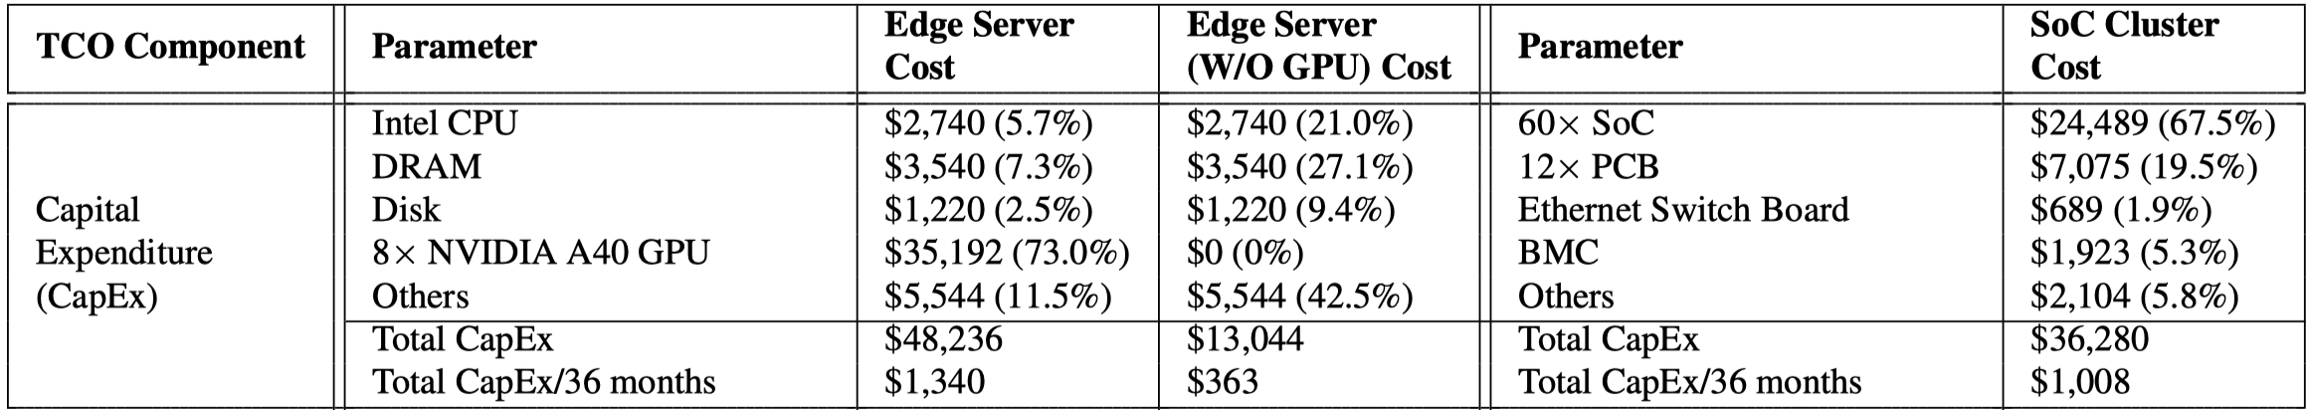
Cost Analysis
Question: If an edge cloud/site is not yet set up, should edge operators purchase SoC Clusters for DL inference and video transcoding?
SoC Cluster’s capital expenditure is comparable to that of an 8-GPU server and is signiﬁcantly higher than that of a CPU server.

Slide 37
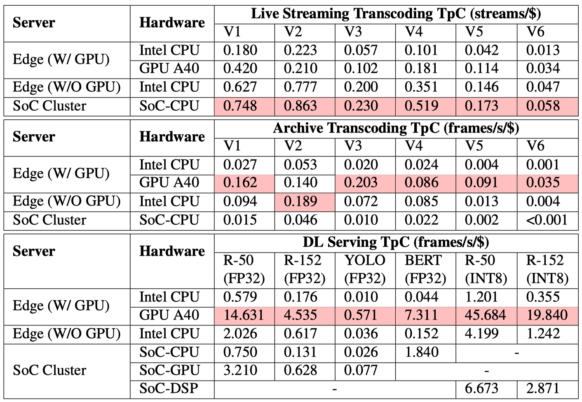
Cost Analysis
Monthly TCO: Capital expenditure / 36 months + Operational expenditure (mainly electricity cost)
Metric: Throughput per cost
SoC Cluster outperforms Intel CPU/NVIDIA GPU servers for live streaming transcoding.

Slide 38
Cost Analysis
Monthly TCO: Capital expenditure / 36 months + Operational expenditure (mainly electricity cost)
Metric: Throughput per cost
SoC Cluster outperforms Intel CPU/NVIDIA GPU servers for live streaming transcoding.
For tasks that demand signiﬁcant computing capacity and those involving highly GPU-optimized workloads, SoC Clusters fall behind.

Slide 39
Cost Analysis
Monthly TCO: Capital expenditure / 36 months + Operational expenditure (mainly electricity cost)
Metric: Throughput per cost
The applicability of SoC Clusters in terms of cost efficiency is largely determined by the workloads.
Utilizing existing, idle SoC Clusters might be a more appropriate approach due to their high capital expenditure.

Slide 40
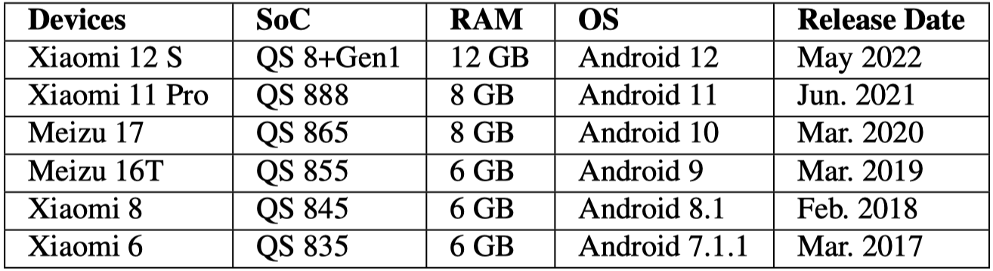
SoC Longitudinal Study
Six Qualcomm Snapdragon 8-series SoC models (2017 – 2022)
Two workloads: DL serving and live streaming transcoding
Metric: Latency and throughput

Slide 41
SoC Longitudinal Study
Tremendous performance improvements in the past six years.
Mobile SoCs are promising candidates for more complex server-side workloads.
Leverage the co-processors to fully unleash their performance.

Slide 42
Conclusion
Energy efficiency is critical to edge platforms.
An extreme design towards energy efficiency: SoC Cluster
Massive low-power mobile processors
Every SoC is inherently heterogeneous (with GPU/NPU/video codec)
Commercial success in mobile cloud gaming services
A set of experiments to demonstrate the pros/cons of SoC Cluster over traditional servers.
More experiments and results in our paper!
Show potential directions for software- and hardware-level optimizations in the future.

Slide 43
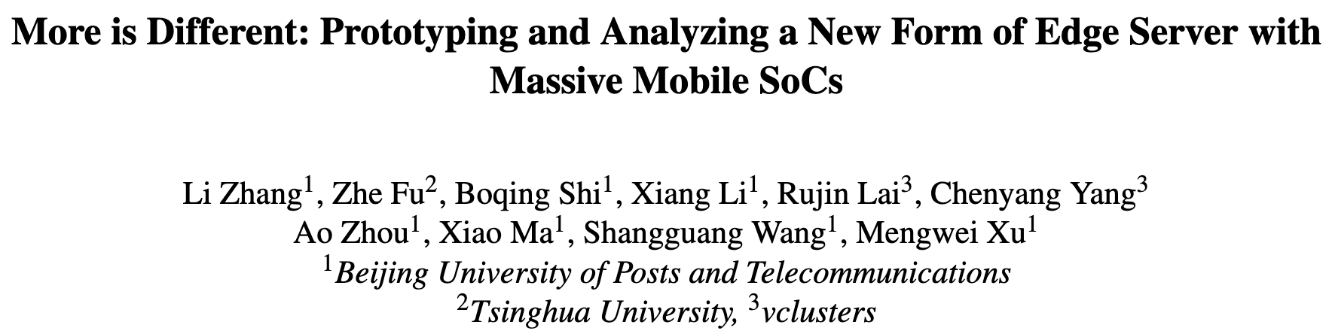
Thank you!
Benchmark suite: https://github.com/SoC-Cluster/SoC-Cluster-artifacts
Online access to cloud phone services powered by SoC Clusters: https://www.alibabacloud.com/help/en/ecp/what-is-ecp
Contact: li.zhang@bupt.edu.cn Website: https://lizhang20.github.io
Happy to take questions about this new type of edge server!

